Slide 1

UV SPECTROSCOPY

Slide 2
Principle
The UV radiation region extends from 200 nm to 400 nm.
Near UV Region: 200 nm to 400 nm
Far UV Region: below 200 nm
Far UV spectroscopy is studied under vacuum condition.

Slide 3
Types of electrons in organic molecule:-
σ electrons : present in the saturated compounds. Do not absorb near UV, but absorb vacuum radiation.
π electrons : present in unsaturated compounds.
E.g.. double and triple bonds.
3.‘n’ electrons : non bonded electrons, not involved in any bonding. E.g. lone pairs of electrons in S, O, N etc.
Any molecule has either n, π, σ or the combination of these electrons.
The bonding and non bonding electrons absorb the characteristic radiation and undergo transition from ground state to excited state.

Slide 4
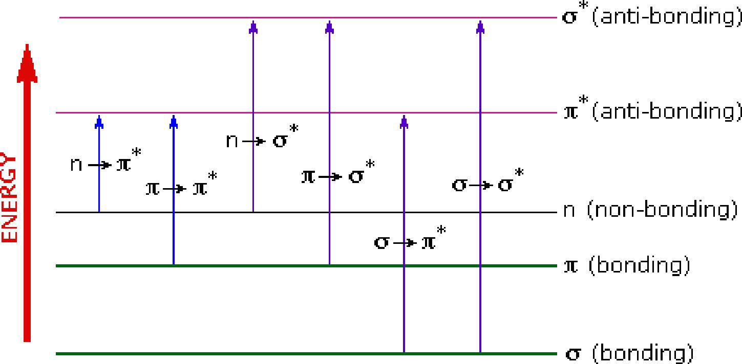
Electronic Transitions

Slide 5
The possible electronic transitions are
1
2
π → π* transition
3
n → σ* transition
σ → σ* transition
4
n → π* transition
5
σ → π* transition
6
π → σ* transition

Slide 6
The order of energy required for these transitions are
σ → σ* >
n → σ* >
π → π* > n → π*

Slide 7
  1) σ → σ* transition
σ electron from bonding orbital is excited to corresponding anti-bonding orbital σ*.
The energy required is large for this transition.
e.g. Methane (CH₄) has C-H bond only and can undergo σ → σ* transition and shows absorbance maxima at 125 nm.

Slide 8
  2) π → π* transition
π electron in a bonding orbital is excited to corresponding anti-bonding orbital π*.
Compounds containing multiple bonds like alkenes, alkynes, carbonyl, nitriles, aromatic compounds, etc undergo π → π* transitions.
e.g. Alkenes generally absorb in the region 170 to 205 nm.

Slide 9
  3) n → σ* transition
Saturated compounds containing atoms with lone pair of electrons like O, N, S and halogens are capable of n → σ* transition.
These transitions usually requires less energy than σ → σ* transitions.
The number of organic functional groups with n → σ* peaks in UV region is small (150 – 250 nm).

Slide 10
  4) n → π* transition
An electron from non-bonding orbital is promoted to anti-bonding π* orbital.
Compounds containing double bond involving hetero atoms (C=O, C≡N, N=O) undergo such transitions.
n → π* transitions require minimum energy and show absorption at longer wavelength around 300 nm.

Slide 11
  5) σ → π* transition and π → σ* transition
These electronic transitions are forbidden transitions & are only theoretically possible.

Slide 12
INSTRUMENTATION
Light source- deuterium lamp
Wavelength selector – monochromator
Prism and Grating
Sample holder- quartz
Detector-photomultiplier tube
Recorder-moving coil meter, digital display, strip chart recorder
UV spectrophotometers can be divided into two main classes
Single beam UV spectrophotometer
Double beam UV spectrophotometer

Slide 13
LIGHT SOURCE
It is important that the power of the radiation source does not change abruptly over its wavelength range. The electrical excitation of deuterium or hydrogen at low pressure produces a continuous UV spectrum.
Both Deuterium and Hydrogen lamps emit radiation in the range 160 - 375 nm.

Slide 14
Hydrogen lamp(180-380 nm)
UV-Vis spectrophotometer have both deuterium & tungsten lamps.
Deuterium lamp(180-380 nm)

Slide 15
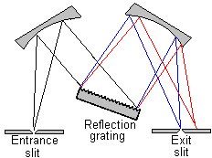
FILTERS OR MONOCHROMATORS
All Monochromators contain the following component parts;
• An entrance slit
• A collimating lens
• A dispersing device (a prism or a grating)
• A focusing lens
• An exit slit

Slide 16
Grating
A grating is a reflective or transmissive optical component with a series of closely spaced, parallel, ruled grooves. The grating is coated with Al to make it reflective. A thin protective layer of silica (SiO2) on top of the Al protects the metal surface from oxidising, which would reduce its reflectivity.

Slide 17
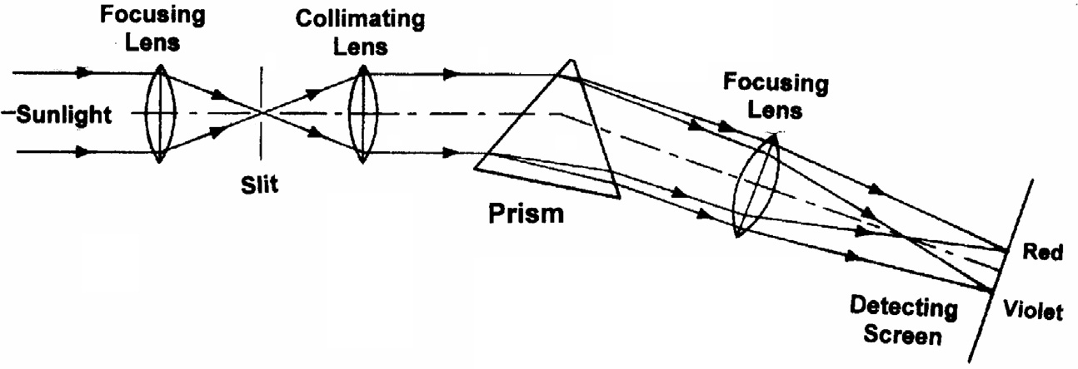
Prisms-
-Prism bends the monochromatic light.
-Amount of deviation depends on wavelength
-They produce non linear dispersion.

Slide 18
SAMPLE CONTAINERS OR SAMPLE CELLS
A variety of sample cells available for UV region. The choice of sample cell is based on
a) the path length, shape, size
b) the transmission characteristics at the desired wavelength
c) the relative expense

Slide 19
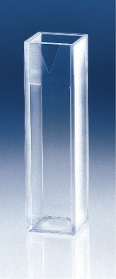
The cell holding the sample should be transparent to the wavelength region to be recorded. Quartz or fused silica cuvettes are required for spectroscopy in the UV region. The thickness of the cell is generally 1 cm. cells may be rectangular in shape or cylindrical with flat ends.

Slide 20
DETECTORS
Three common types of detectors are used
Barrier layer cell
Photo multiplier tube
Photo emissive cells
I. Barrier layer cells
It consist of flat Cu or Fe electrode on which semiconductor such as selenium is deposited. On the selenium a thin layer of silver or gold is sputtered over the surface.

Slide 21
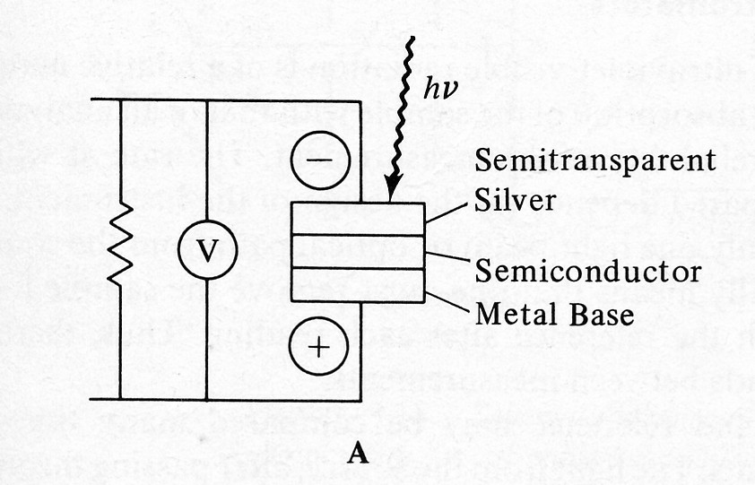

Slide 22
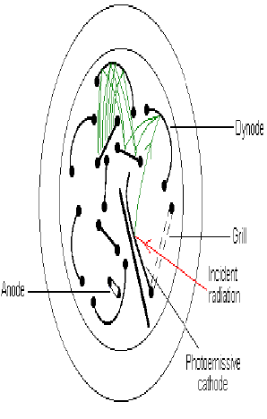
II. Photomultiplier Tube
Diagram of a photomultiplier tube with 9 dynodes. Amplification of the signal occurs at each dynode, which is approximately 90 volts more positive than the previous dynode.

Slide 23
III. Photo emissive cell
It consists of cathode coated with photo emissive material like cesium oxide or potassium oxide or silver oxide.
A metal ring is inserted near the cathode acts as anode.
The interior of the bulb is evacuated or may be filled with an inert gas at low pressure (i.e. argon ).

Slide 24
When light, penetrating the bulb, falls on the sensitive layer, electrons are emitted, thereby causing a current to flow through an outside circuit, this current is amplified by electronic means and is taken as a measure of the light striking the photosensitive surface.

Slide 25
IV. Silicon Diode transducers
It consists of a reverse-biased pn junction formed on a silicon chip.
The reverse bias creates a depletion layer that reduces the conductance to nearly zero.
If radiation is allowed to fall on the chips holes, electrons are formed in the depletion layer and swept through the device to produce a current that is proportional to the radiant power.

Slide 26
p-n junction
Metal contact
Wire lead
p- region
n- region
hole
electron

Slide 27
Recorder
A readout device is simply a piece of electronic instrumentation that displays the current from the detector in some relevant units (absorbance or percentage transmittance).
The different readout devices are:
Moving coil meter
Digital display
Strip chart recorder

Slide 28
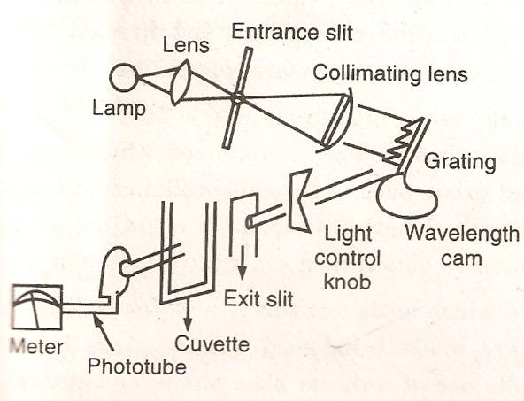
1.Single beam UV Spectrophotometer

Slide 29
2. Double beam UV Spectrophotometer
source
reference
Monochromator/beam splitter
detector
recorder
sample

Slide 30
Applications of UV spectroscopy
I. Quantitative analysis
II. Qualitative analysis
I. Quantitative analysis
I.1 Quantitative analysis of single component samples
The concentration of a drug or absorbing substance in a given sample can be easily analyzed by measuring the absorbance of the solution prepared in a transparent solvent in a UV spectrophotometer.

Slide 31
This quantitative UV method is applicable to determine the concentration of a single component in the given sample and to determine the concentration of different components in a mixture
The methods adopted to analyze single component samples are
a)Standard absorptivity value method
b)Calibration curve method
c)Single or double point standardization method

Slide 32
I.2 Quantitative analysis of substances in multicomponent samples.
The identification and concentration of one or more components in the sample can be analyzed by modifying the simple spectrophotometric procedure adopted in single component samples.
The different multicomponent analytical methods are
a. Using absorbance corrected for interference
b. After solvent extraction of the sample
c. Simultaneous equation method
d. Absorption ratio method
e. Geometric correction method
f. Orthogonal polynomial method

Slide 33
II. Qualitative analysis
1 Detection of Chromophoric groups
The absence of a band at particular wavelength may be regarded as evidence for the absence of a specific chromophore in a compound.
If the spectrum is transparent above 200 nm, it shows the absence of
a) conjugation/unsaturation
b) carbonyl compounds like aldehydes and Ketone
c)benzene or aromatic compounds
d) bromo or iodo atoms

Slide 34
II.2 Detection of Extent of Conjugation
Presence of alternate single and double bond(may be present in Chromophoric groups) in a molecule is generally referred as conjugated system.
If two or more chromophoric groups are present in a molecule and they are separated by two or more single bonds the effect on the spectra is usually additive.
H₂C=CH Ethylene 174 nm
-C=C-C=C - Butadiene 217 nm

Slide 35
II.3 Distinction of conjugated and non-conjugated diene
Example: The non conjugated ethylene having one double bond has λ_{max} at 174 nm can be easily distinguished from butadiene which appears at longer wavelength(λ_{max} 217nm),due to the presence of conjugated double bond.

Slide 36
II.4 Detection of impurities
If a substance is contaminated with impurity, the impurity will also absorb light at different wavelength, then the absorption spectra of impure substance will differ from characteristic absorption of pure substance.
Eg:- The drug adrenaline in N/100 HCl shows λ_{max} at 280 nm and the presence of impurity adrenalone in adrenaline can be detected from its absorption maximum at 310 nm.

Slide 37
II.5 Identification of unknown compound
An unknown compound can be identified by comparing its spectrum with the known spectra. If the two spectra coincide, the two compounds must be identical. If the two spectra do not coincide, then the expected structure is different from the known compound.

Slide 38
II.6 Detection of Polynuclear hydrocarbons
Benzene and polynuclear compounds have characteristic spectra in Ultra-violet and Visible radiation.
Thus the identification of polynuclear hydrocarbons can be made by comparison with the spectra of known polynuclear compounds.
The presence of substituents on the ring and increase in number of rings shift the absorption maximum to longer wavelength.
Eg: Benzene shows absorption maximum at 256 nm. The methyl group (toluene) substitution in benzene ring results in the shift of λ_{max} from 256 to 261 nm.

Slide 39
II.7 Structural elucidation
Elucidation of structure is another important qualitative application of UV Spectroscopy.
For E.g structures of Vitamin A₁ and A₂ can be easily elucidated by UV spectra. Vitamin A₁ absorbs at 325 nm and Vitamin A₂ absorbs at 351 nm. The absorption maximum appears at longer wavelength for Vitamin A₂ due to the presence of additional ethylenic bond.

Slide 40
II.8 Detection of possible tautomers
If a molecule exists in two tautomeric forms, prevalence of one over the other can be detected by ultra-violet spectroscopy.

Slide 41
II.9 Determination of configuration of Geometrical isomers:
Cis and trans isomers of a molecule can be distinguished by steric hindrance in UV spectroscopy. The results of absorption show that cis compounds absorb at different wavelengths as compared to that of trans isomer.
Cis- stilbene shows λ_{max} at 283 nm where as trans-stilbene shows λ_{max} at 295.5 nm. A distortion in coplanarity due to steric hindrance results lower value in λ_{max} and lower extinction coefficient(ε_{max} 12300) in cis-stilbene.

Slide 42
THANK YOU

