Slide 1
BINULALC
ASSISTANT PROFESSOR
DEPARTMENT OF PHARMACEUTICS

Slide 2
CONTENTS
Introduction
Mechanisms of protein drug binding
Classes of protein drug binding.
Binding of drug to blood components.
Plasma proteins
Blood cells
Binding of drug to extravascular tissue protein
Factors affecting protein drug binding
Significance of protein/tissue binding of drug
Kinetics of protein binding

Slide 11
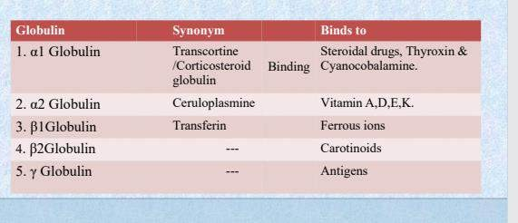

Slide 14
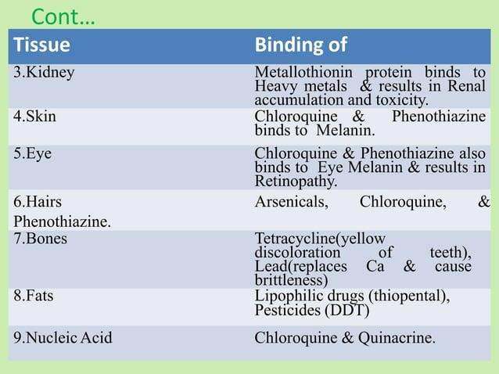

Slide 15
