Slide 1
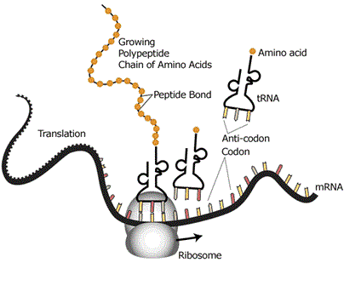
TRANSLATION

Slide 2
Translation is the process by which proteins are synthesized from the information contained in messenger RNA (mRNA)
mRNA sequence is read using the genetic code and are translated into a sequence of 20 amino acids, which are the building blocks of proteins
Occurs in ribosomes in cytosol

Slide 3
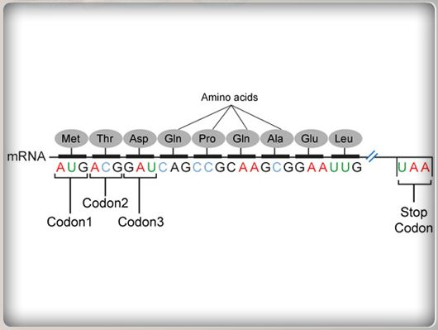
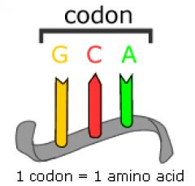

Slide 4
Requirements
mRNA - Template for protein synthesis
tRNAs - Adapters in protein synthesis
Ribosomes - Molecular machinery for protein synthesis
Energy [ATP, GTP]
Enzymes and specific factors

Slide 5
Ribosome consists of
1 mRNA binding site
3 tRNA binding sites –
Amino acyl tRNA [A] site
Peptidyl tRNA [P] site
Exit [E] site

Slide 6
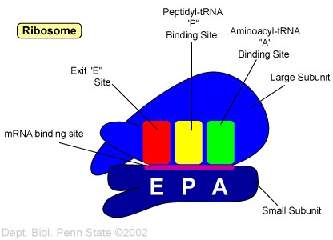

Slide 7
Steps involved in translation
5 major stages–
Activation of amino acid
Initiation
Elongation
Termination
Folding and processing

Slide 8
1. Activation of amino acid
Each of 20 amino acid is covalently attached to respective tRNA by 20 different amino acyl tRNA synthetases, specific for each amino acids
Carboxyl group of amino acid is esterified to hydroxyl group of ribose at 3’ end of tRNA chain

Slide 9
Now the tRNA is referred to as charged mRNA and the amino acid as activated amino acid

Slide 10
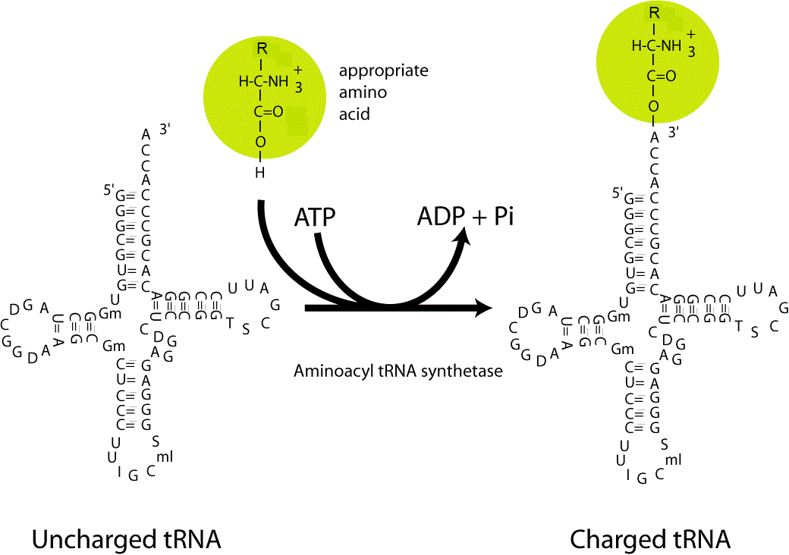

Slide 11
Only when amino acid is attached to tRNA, it can recognize a codon of mRNA using anticodon

Slide 12
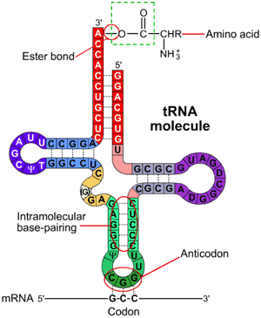

Slide 13
2. Initiation
Ribosomal dissociation –
80S → 60S + 40S
40S + IF → prevents reassociation with 60S
Formation of 43S pre-initiation complex –
GTP + IF + methionyl-tRNA
This ternary complex + 40S → 43S pre-initiation complex

Slide 14
Formation of 48S initiation complex –
43S pre-initiation complex+ mRNA → 48S initiation complex
Binding facilitated by 5’ cap
Formation of 80S initiation complex –
48S initiation complex + 60S → 80S initiation complex
Now tRNA is on P site of ribosome & is now ready for elongation

Slide 15
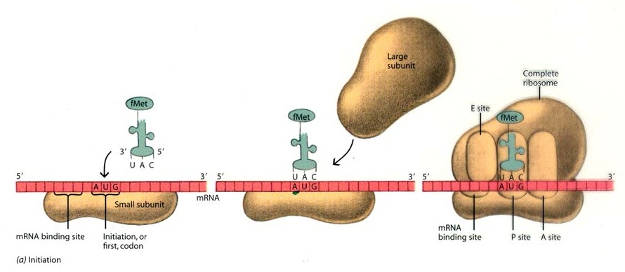

Slide 16
3. Elongation
Binding of amino acyl tRNA to A site –
EF + GTP + amino acyl tRNA
The complex allow amino acyl tRNA to enter A site with release of EF + GDP + Pi
Formation of new peptide bond [transpeptidation] –
New peptide bond formed between amino acids on A & P sites, catalyzed by peptidyl transferase
Thus now a dipeptidyl tRNA on A site and empty initiating tRNA remains at P site

Slide 17
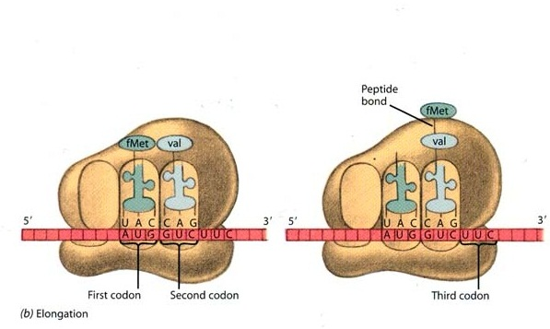

Slide 18
Translocation –
Ribosome move along mRNA towards 3’ end by a distance of 1 codon
This causes shifting of dipeptidyl tRNA from A site to P site and empty tRNA from P site to E site [translocation]
The empty tRNA is eliminated from E site with the entry of next amino acyl tRNA to A site
Now ready for another elongation cycle
Process repeats until a termination codon is reached

Slide 19
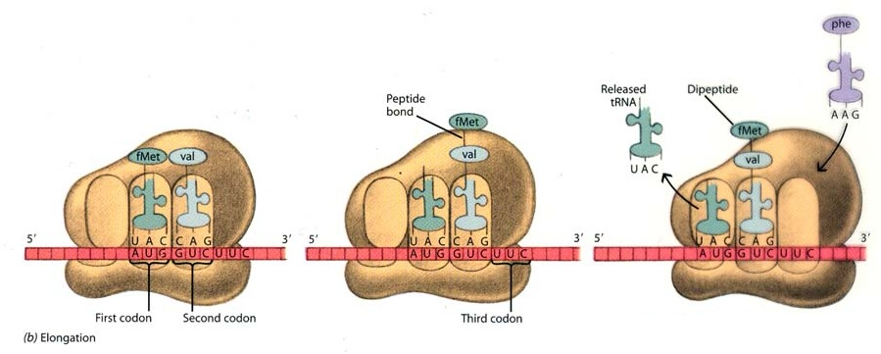

Slide 20
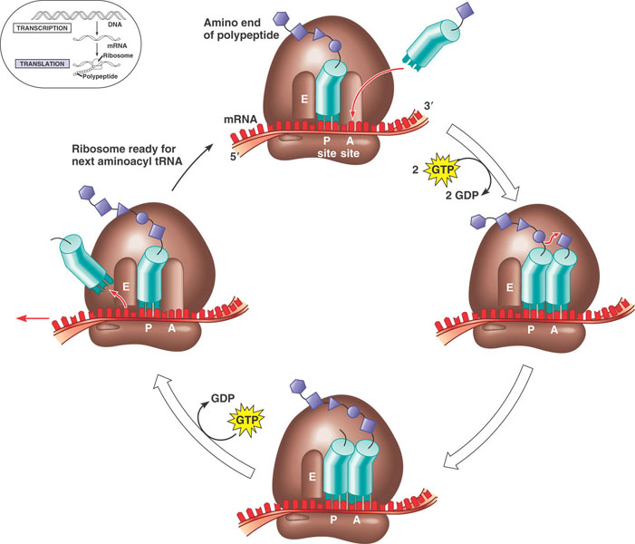

Slide 21
4. Termination
Elongation is continued until nonsense codon appears at A site
Once appeared releasing factors recognize the termination signals
Release polypeptide, tRNA & mRNA from ribosome
80S → 60S + 40S, and recycled

Slide 22
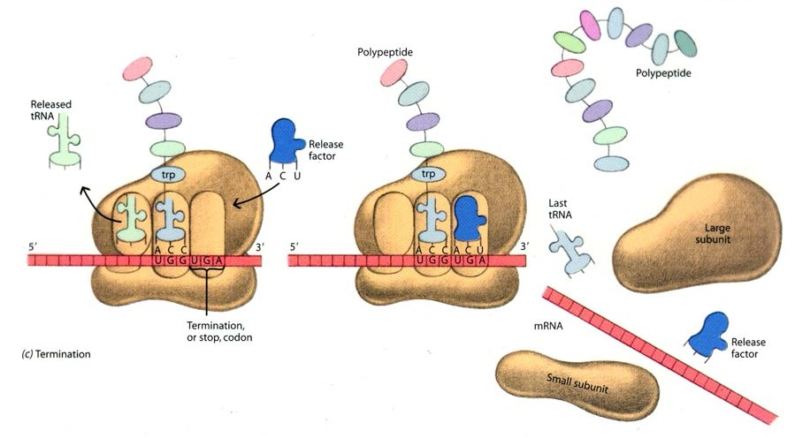

Slide 24
The formed polypeptide has 2 ends
C-terminus (carboxy terminus)
N-terminus (amino terminus)

Slide 25
5. Folding and processing
To achieve biologically active form, the newly formed polypeptide undergo folding into proper 3D structures
Before or after, undergo enzymatic processing
Collectively known as post translational modifications

Slide 26
Amino terminal and carboxyl terminal modifications –
Initially all peptides begin with methionine
Amino terminal methionine & carboxyl terminal residues may be removed enzymatically
Amino group of amino terminus is acetylated
Loss of signal sequence –
15-30 animo acids at N-terminus is required for directing the peptide to its ultimate destination in the cell, which are later removed by peptidases

Slide 27
Attachment of carbohydrate side chains –
In glycoproteins, carbohydrate side chains are covalently attached
Addition of isoprenyl groups –
A thio ester bond is formed between isoprenyl group and cysteine residues of protein eg: G-protein
Addition of prosthetic groups –
Many proteins require prosthetic groups which are attached after leaving ribosome eg: heme group in cyt-C

Slide 28
Proteolytic processing –
Some larger, inactive precursor proteins are later proteolytically trimmed to produce final active forms eg: insulin, trypsin
Formation of disulfide cross linkage –
Undergo spontaneous folding into active conformations by disulfide bridges between cysteine residues

Slide 30
Inhibitors
Streptomycin – bind 30S, cause misreading between codon-anticodon, prevent initiation in prokaryotes
Tetracyclin – bind 30S, prevent adequate binding of amino acyl tRNA to A site in prokaryotes
Chloramphenicol – bind 50S, block peptidyl transferase reaction in prokaryotes
Erythromycin – bind 50S, inhibit translocation in prokaryotes

Slide 31
Puromycin – premature chain termination by acting as an analog of amino acyl tRNA in prokaryotes &eukaryotes
Cycloheximide – inhibit peptidyl transferase activity of 60S in eukaryotes

