Slide 1
RHEUMATOID ARTHRITIS

Slide 2
Rheumatoid arthritis an autoimmune disease that results in chronic systemic inflammatory disorder that may affect many tissues and organs, but principally attacks flexible (synovial) joints. .
It can be a disabling and painful condition, which can lead to substantial loss of functioning and mobility if not adequately treated

Slide 3
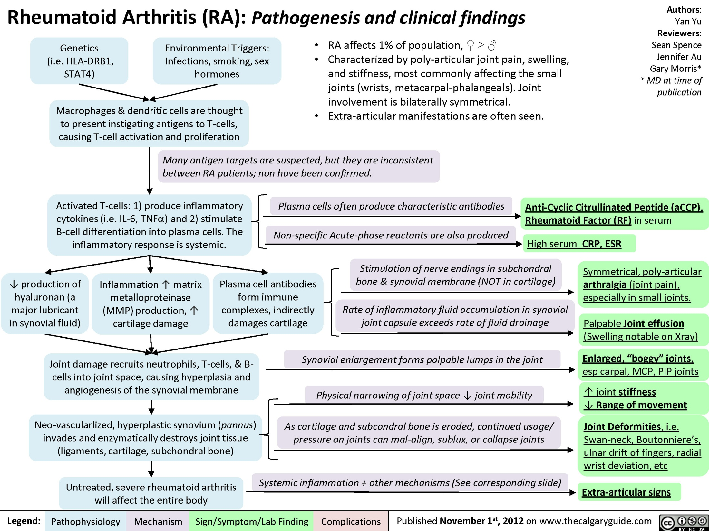

Slide 4
PATHOPHYSIOLOGY
RA results from a dysregulation of the humoral and cell-mediated components of the immune system.
Most patients produce antibodies called rheumatoid factors
Immunoglobulins can activate the complement system, which amplifies the immune response by enhancing chemotaxis, phagocytosis, and release of lymphokines by mononuclear cells that are then presented to T lymphocytes.

Slide 5
The processed antigen is recognized by the major histocompatibility complex proteins on the lymphocyte surface, resulting in activation of T and B cells.
TNF & Interleukin- 1 are proinflammatory cytokines
Activated T cell produce cytotoxins
Activated B cells produce plasma cells, which form antibodies that, in combination with complement, result in accumulation of granulocytes

Slide 6
Granulocytes release cytotoxins, oxygen free radicals, and hydroxyl radicals that promote cellular damage to synovium and bone.
Vasoactive substances (histamine, kinins, prostaglandins) are released at sites of inflammation, increasing blood flow and vascular permeability.
This causes edema, warmth, erythema, and pain and makes it easier for granulocytes to pass from blood vessels to sites of inflammation.

Slide 7
Rheumatoid arthritis passes through four stages.
The first stage is the inflammation of the synovial membrane (synovitis), causing congestion and oedema.
The next stage is the formation of pannus. A layer of inflammatory tissue forms in the joint capsule.
Fibroblasts, leucocytes, lymphocytes, plasma cells and other materials multiply from the synovial membrane leading to a pannus tissue which invades the cartilage and slowly replace it with tough fibrous tissue.

Slide 8
The disease progresses to the next stage known as fibrous ankylosis. This involves the conversion of the articular cartilage of the joint into fibrous tissue thereby inhibiting motion of the joint.
The final stage is the bony ankylosis. In this stage, the bones of the joint fuse together thereby making mobility impossible

Slide 9
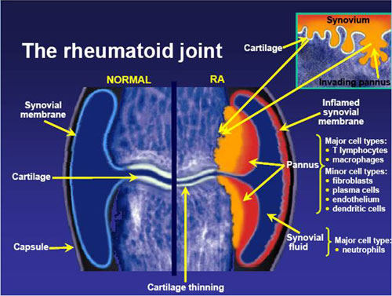

Slide 10
Presentation of Rheumatoid Arthritis
General
• About 60% of patients develop symptoms gradually over several weeks to months.
• Patients may present with systemic findings, joint findings, or both.
Symptoms
• Nonspecific systemic symptoms may include fatigue,weakness, anorexia and diffuse musculoskeletal pain
• Patients complain of pain in involved joints and prolonged morning joint stiffness.

Slide 11
Joint stiffness worsen in the morning, usually exceeds 30 minutes & may persists all day
On examination joint swelling may be visible
Tissue feels soft & spongy & may appear erythematous & warm
chronic joint deformities involve subluxations of the metacarpophalangeal (MCP), proximal interphalangeal (PIP), metatarsophalangeal (MTP), and wrist joints are involved frequently

Slide 12
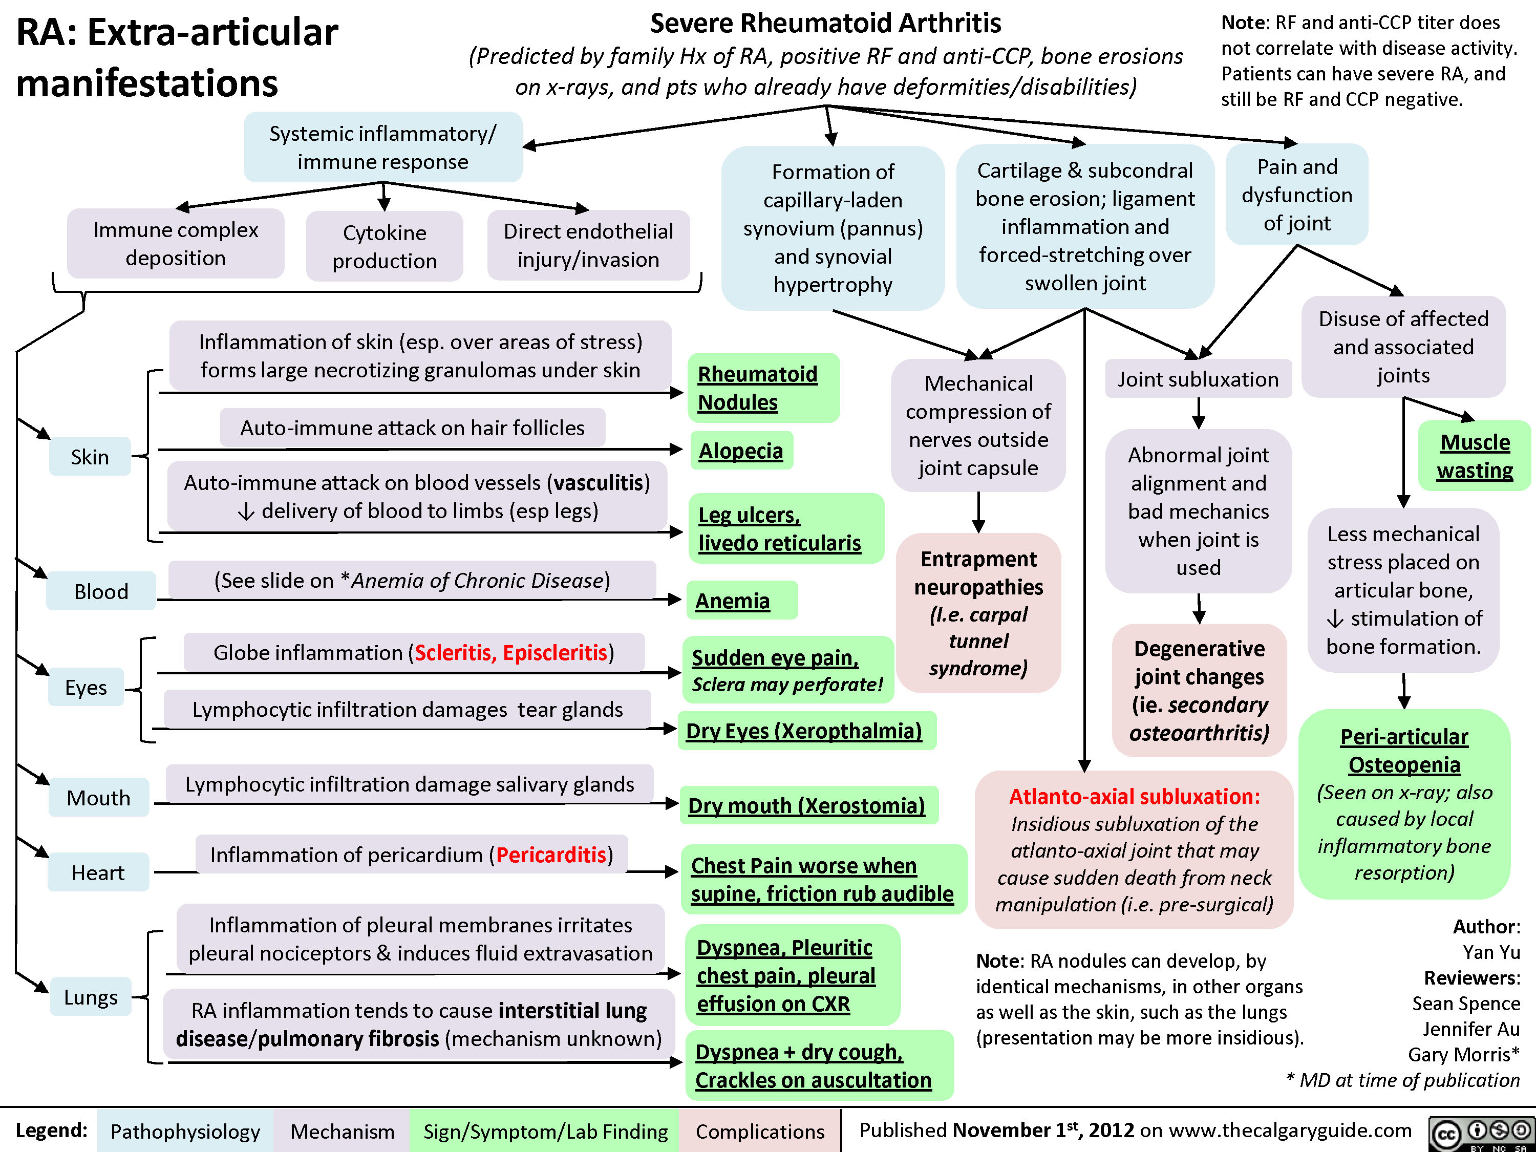

Slide 13
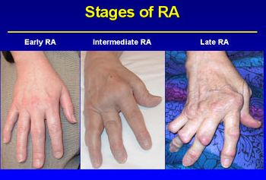

Slide 14
Laboratory Tests
• Positive rheumatoid factor (negative in up to 30% of patients)
• Elevated erythrocyte sedimentation rate (Westergren ESR: greater than 20 mm/hour men; greater than 30 mm/hour women)
• Elevated CRP (greater than 0.7 mg/dL or greater than 7 mg/L)
• Complete blood count: Slight elevation in white blood cell count with a normal differential; slight anemia, thrombocytosis
• Positive anti- Cyclic Citrullinated Peptide

Slide 15
Other Diagnostic Tests
• Synovial fluid analysis: Straw colored, slightly cloudy, 5000 to 25,000 WBCs/mm3 (5–25 × 109/L), negative if cultured
• Magnetic resonance imaging: May detect erosions earlier in the course of disease than x-rays but is not required for diagnosis

Slide 16
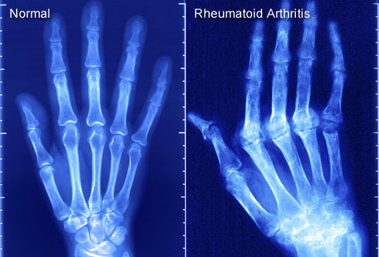
Joint x-rays: To establish baseline and evaluate joint damage

Slide 17
TREATMENT
Desired Outcomes
The goals of treatment in RA are to
(1) reduce or eliminate pain
(2) protect articular structures
(3) control systemic complications
(4) prevent loss of joint function
(5) improve or maintain quality of life

Slide 18
ACR GUIDELINES
The new criteria are as follows:
1) morning stiffness in and around joints lasting at least 1 hour before maximal improvement
2) soft tissue swelling (arthritis) of 3 or more joint areas observed by a physician
3) swelling (arthritis) of the proximal interphalangeal, metacarpophalangeal, or wrist joints
4) symmetric swelling (arthritis);
5) rheumatoid nodules
6) the presence of rheumatoid factor;
7) radiographic erosions and/or periarticular osteopenia in hand and/or wrist joints.
Criteria 1 through 4 must have been present for at least 6 weeks. Rheumatoid arthritis is defined by the presence of 4 or more criteria, and no further qualifications (classic, definite, or probable) or list of exclusions are required.

Slide 19
NONPHARMACOLOGIC THERAPY
Adequate rest, weight reduction if obese, occupational therapy, physical therapy, and use of assistive devices may improve symptoms and help maintain joint function.
Patients with severe disease may benefit from surgical procedures such as tendon repair, and joint replacements.
Patient education about the disease and the benefits and limitations of drug therapy is important.

Slide 20
PHARMACOLOGIC THERAPY
A. Disease modifying antirheumatic drugs DMARDS)
1. Immunosuppressants: Methotrexate,Azathioprine, Cyclosporine
2. Sulfasalazine
3. Chloroquine or Hydroxychloroquine
4. Leflunomide
5. Gold sod. thiomalate, Auranofin
6. d-Penicillamine
B. Biologicc response modifiers (BRMs)
1.TNF alpha inhibitors: Etanercept, Infliximab,adalimumab
2. IL-1 antagonist- Anakinra
C. Adjuvants
Corticosteroids, Prednisolone and others
D. NSAIDs

Slide 21
Nonsteroidal Antiinflammatory Drugs
NSAIDs act primarily by inhibiting prostaglandin synthesis, which is only a small portion of the inflammatory cascade.
They possess both analgesic and antiinflammatory properties and reduce stiffness but do not slow disease progression or prevent bony erosions or joint deformity.
They should seldom be used as monotherapy for RA; instead, they should be viewed as adjuncts to DMARD treatment.

Slide 22
Drugs
Aspirin 2.6–5.2 g Four times daily
Celecoxib 200–400 mg — Once or twice daily
Diclofenac 150–200 mg — 3 to 4 times daily;extended release: twice daily
Diflunisal 0.5–1.5 g — Twice daily
Etodolac 0.2–1.2 g (max, 20mg/kg)—2 to 4 times daily
Fenoprofen 0.9–3 g — 4 times daily
Flurbiprofen 200–300 mg — 2 to 4 times daily
Ibuprofen 1.2–3.2 g 20–40 mg/kg 3 to 4times daily

Slide 23
Disease modifying antirheumatic drugs
Methotrexate
MTX inhibits cytokine production and purine biosynthesis, which may be responsible for its antiinflammatory properties. Its onset is relatively rapid.
Toxicities are GI (stomatitis, diarrhea, nausea, vomiting), hematologic (thrombocytopenia, leukopenia), pulmonary (fibrosis, pneumonitis), and hepatic (elevated enzymes, rare cirrhosis).
Concomitant folic acid may reduce some adverse effects without loss of efficacy.

Slide 24
MTX is teratogenic, and patients should use contraception and discontinue the drug if conception is planned.
MTX is contraindicated in pregnant and nursing women, chronic liver disease, immunodeficiency.

Slide 25
Leflunomide
Inhibits pyrimidine synthesis, which reduces lymphocyte proliferation and modulation of inflammation.
A loading dose of 100 mg/day for the first 3 days may result in a therapeutic response within the first month.
The usual maintenance dose of 20 mg/day may be lowered to 10 mg/day in cases of GI intolerance, complaints of hair loss, or other dose-related toxicity.
The drug may cause liver toxicity and is contraindicated in patients with preexisting liver disease

Slide 26
Hydroxychloroquine
They lacks the myelosuppressive, hepatic, and renal toxicities seen with some other DMARDs, simplifies its monitoring.
Its onset may be delayed for up to 6 weeks, but the drug should not be considered a therapeutic failure until after 6 months of therapy with no response.
nausea, vomiting, diarrhea, accommodation defects, benign corneal deposits, blurred vision, night blindness, rash, alopecia, skin pigmentation ,headache, vertigo & insomnia are adverse effects.

Slide 27
Sulfasalazine
Use is often limited by adverse effects.
Antirheumatic effects should be seen in 2 months.
Adverse effects include anorexia, nausea, vomiting, diarrhea, rash, urticaria, leukopenia,elevated enzyme effects.
GI symptoms may be minimized by starting with low doses, dividing the dose more evenly throughout the day, and taking the drug with food

Slide 28
Aurothioglucose and gold sodium thiomalate are intramuscular (IM) gold preparations with an onset that may be delayed for 3 to 6 months.
They require weekly injections for about 22 weeks before a less frequent maintenance regimen may be initiated.
Auranofin is an oral gold preparation that is more convenient but less effective than IM gold.
Adverse effects -nausea, vomiting, diarrhea, rash, stomatitis ,proteinuria, hematuria, anemia, leukopenia, thrombocytopenia

Slide 29
Azathioprine
Is a purine analog that is converted to 6-mercaptopurine and is thought to interfere with DNA and RNA synthesis.
Antirheumatic effects may be seen in 3 to 4 weeks.
It should be discontinued if no response is observed after 12 weeks at maximal doses.
Its major adverse effects are bone marrow suppression (leukopenia, macrocytic anemia, thrombocytopenia, pancytopenia), stomatitis, GI intolerance, infections, drug fever, hepatotoxicity, and oncogenic potential.

Slide 30
Penicillamine
Onset may be seen in 1 to 3 months, and most responses occur within 6 months.
Early adverse effects - skin rash, metallic taste, stomatitis, anorexia, nausea, vomiting, dyspepsia & glomerulonephritis
Penicillamine is usually reserved for patients who are resistant to other therapies

Slide 31
Cyclosporine
Reduces production of cytokines involved in T-cell activation and has direct effects on B cells, macrophages, bone, and cartilage cells.
Its onset appears to be 1 to 3 months.
Important toxicities - hypertension, hyperglycemia, nephrotoxicity, tremor, GI intolerance, hirsutism, and gingival hyperplasia.
Cyclosporine should be reserved for patients refractory to or intolerant of other DMARDs.

Slide 32
Biologic Agents
Etanercept
Is a fusion protein & it binds to and inactivates TNF, preventing it from interacting with the cell-surface TNF receptors and thereby activating cells.
It has been shown to slow erosive disease progression to a greater degree than oral MTX in patients with inadequate response to MTX monotherapy.
Adverse effects include local injection-site reactions, pancytopenia and neurologic demyelinating syndromes.
No laboratory monitoring is required.

Slide 33
Infliximab
It binds to TNF and prevents its interaction with TNF receptors on inflammatory cells.
To prevent formation of antibodies to this foreign protein, MTX should be given orally in doses used to treat RA for as long as the patient continues on infliximab
Infliximab may increase the risk of infection, especially upper respiratory infections. An acute infusion reaction with fever, chills, pruritus, and rash may occur within 1 to 2 hours after administration.

Slide 34
Adalimumab
Is a human IgG1 antibody to TNF that is less antigenic than infliximab.
It has response rates similar to other TNF inhibitors.
Local injection site reactions were the most common adverse event reported in clinical trials.
It has the same precautions regarding infections as the other biologics.

Slide 35
Anakinra
IL-1 normally stimulates release of chemotactic factors and adhesion molecules that promote migration of inflammatory leukocytes to tissues.
The drug is approved for moderately to severely active RA in adults who have failed one or more DMARDs.
It can be used alone or in combination with any of the other DMARDs except for TNF-blocking agents.
Injection-site reactions were the most common adverse effect (e.g., redness, swelling, pain). Infection risk and precautions are similar to those for the TNF inhibitors.
100 mg s.c daily dose

Slide 36
Rituximab
It binding to B cells results in nearly complete depletion of peripheral B cells
Rituximab is useful in patients failing MTX or TNF inhibitors.
Methylprednisolone 100 mg should be given 30 minutes prior to rituximab to reduce the incidence and severity of infusion reactions.
Acetaminophen and antihistamines may also benefit patients who have a history of reactions.
MTX should be given concurrently in the usual doses for RA to achieve the best therapeutic outcomes.

Slide 37
Corticosteroids
Corticosteroids have anti inflammatory and immunosuppressive properties. They interfere with antigen presentation to T lymphocytes, inhibit prostaglandin and leukotriene synthesis, and inhibit neutrophil and monocyte superoxide radical generation.
Oral corticosteroids (e.g., prednisone, methylprednisolone) can be used to control pain and synovitis

Slide 38
EVALUATION OF THERAPEUTIC OUTCOMES
• Clinical signs of improvement include reduction in joint swelling, decreased warmth over actively involved joints, and decreased tenderness to joint palpation.
• Symptom improvement includes reduction in joint pain and morning stiffness, longer time to onset of afternoon fatigue, and improvement in ability to perform daily activities.

Slide 39
Periodic joint radiographs may be useful in assessing disease progression.
Laboratory monitoring is of little value in monitoring response to therapy but is essential for detecting and preventing adverse drug effects
Patients should be questioned about the presence of symptoms that may be related to adverse drug effects

Slide 40
Mild disease and no erosions
ALGORITHM
Yes
No
NSAID or aspirin +
non drug therapy
Combination therapy with
Adequate
Response?
No
Yes
Disease modifying antirheumatic drugs
Methotrexate
Lenflunomide,gold
Sulfasalazine,hydroxychloroquine
Continue Rx
Adequate response
No

Slide 41
Try another DMARD above or consider
Azathioprine, Etanercept
Infiximab,penicillamine
Adequate
Response?
No
Yes
Cyclosporine or
Combination DMARD
Continue Rx
Adequate
response ?
No
Cyclosphosphamide or investigational drug

