Slide 1
Autonomic Nervous System
Dr. MOHAMMAD MANSOOR
Professor
Dept of Pharmacology
Devaki amma memorial college of pharmacy
Chelmbra, Mallapuram ( dist)
Kerala

Slide 2
Lecture-3 :Sympathetic Nervous System
Sympathetic Nervous System
Sympathetic Preganglionic Neurons
Sympathetic Ganglia
Postganglionic Sympathetic Neurons
Distribution of Sympathetic neurons
Effect of Sympathetic stimulation

Slide 3
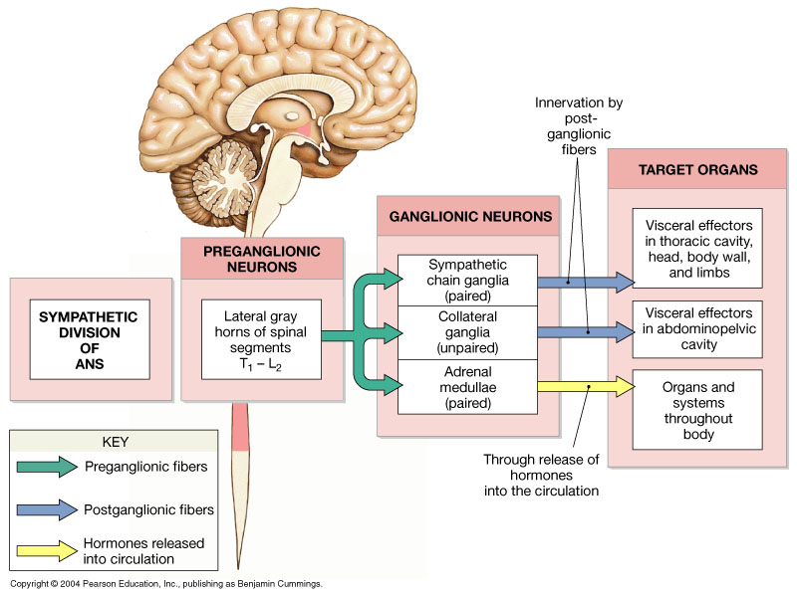
Organization: Sympathetic NS

Slide 4
Sympathetic Nervous System
Also calledThoracolumbar system
All preganglionic sympathetic fibers
    Arises from lateral horn of spinal cord
    Leave the spinal cord with the ventral roots of the spinal nerve
    Cell body located in gray matter from T1-L2
Sympathetic trunk extend the entire length of spinal cord
Post ganglionic fibers pass to effector organ

Slide 5
Sympathetic Nervous System
All preganglionic sympathetic fibers-
Arises from lateral horn of spinal cord
Leave the spinal cord with the ventral roots of the spinal nerve
Cell body located in gray matter from T1-L2

Slide 6
Sympathetic Nervous System
All preganglionic sympathetic fibers are:
    Short
    Myelinated
    Type B fiber
Leave the spinal cord via ventral root
Pass via the white rami communicates to the paravertebral ganglia
Terminates in sympathetic ganglia
Synapses with postganglionic neurons

Slide 7
Sympathetic Nervous System
Destination of the preganglionic fibers after reaching the sympathetic trunk
Preganglionic fibres after reaching the sympathetic trunk may-
  Terminate in the same ganglia that it enters
  Pass upward & terminate in the other ganglia
  Pass downward & terminate in the other ganglia
  Leave the sympathetic trunk without synapsing & terminate in other ganglia which lies out side the sympathetic trunk

Slide 8
Sympathetic Ganglia
Ganglia: Structures where synapsing between pre and post ganglionic fibers occurs
One preganglionic fiber synapses with several post ganglionic neurons
Important groups of sympathetic ganglia are-
    Sympathetic trunk (Paravertebral ganglia)
    Prevertebral ganglia
    Peripheral ganglia

Slide 9
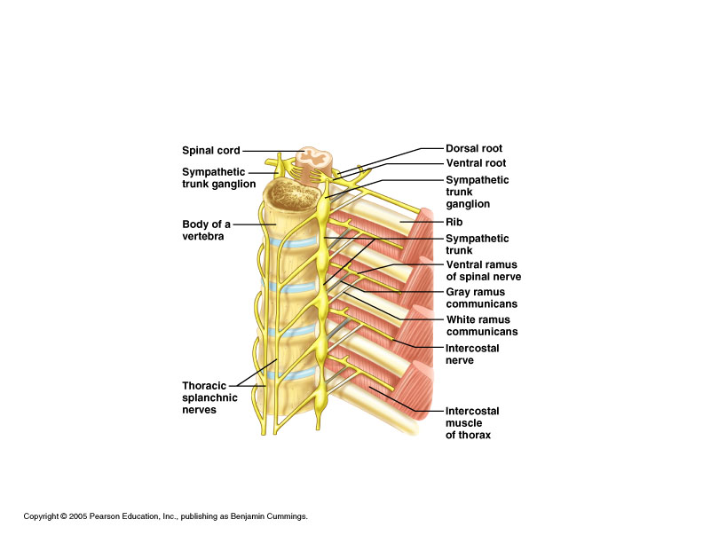
Sympathetic Trunk Ganglia

Slide 10
Postganglionic Sympathetic Neuron
All Postganglionic Sympathetic Neuron arises from sympathetic ganglia
Cell body located in ganglion
These are -
        Short &
        Nonmyelinated
        Type C fibers

Slide 11
Postganglionic Sympathetic Neuron
Postganglionic Sympathetic Fibers may-
Pass through gray ramus communicantes and re-enter ventral root to reach a spinal nerve and innervate the-
        Sweat gland
        Blood vessels
        Piloerector muscle

Slide 12
Postganglionic Sympathetic Neuron
Postganglionic Sympathetic Fibers may-
Pass through gray ramus communicantes and re-enter ventral root to reach a spinal nerve
Reach a cranial nerve through communicating branch & distributed through it
Pass into a vascular branch and distributed to branches of vessels
Innervate the visceral organs

Slide 13
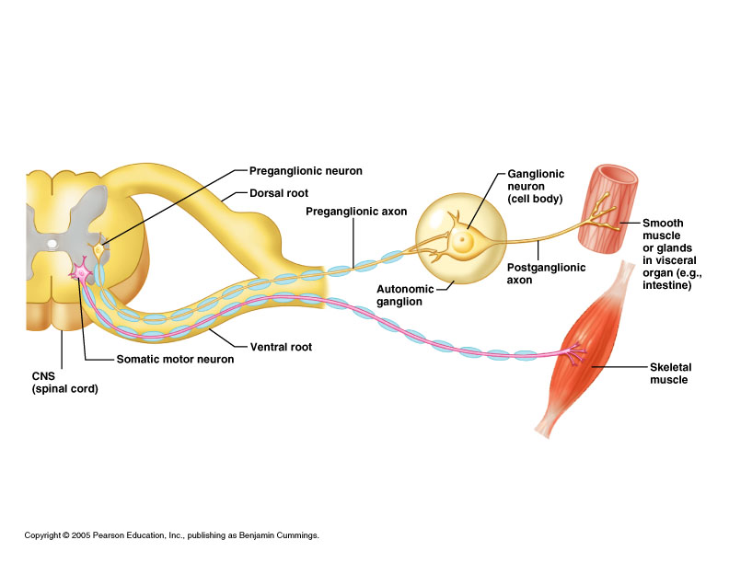

Slide 14
Distribution of Sympathetic neurons
Segmental level
T1,T2
T3,T4
T5 toT9
T10 to L2
T6 toT12
L1,L2
T1toT12
Area of distribution
Head & Neck
Thoracic viscera
Upper limb
Lower Limb
Upper Abdominal Viscera
Lower Abdominal Viscera
Thoracic & abdominal Vessels

Slide 15
Effect of Sympathetic stimulation
System/organ
CVS
Heart
    SAN
    AVN
    Purkinje Fibers
    Myocardium
Blood Vessels
Effects
Cardiac stimulation
+ve Chronotropic Effect
+ve Dromotropic Effect
+ve Bathmotropic Effect
+ve Inotropic Effect
Vasoconstriction – Splanchnic
Cutaneous
Vasodilatation-skeletal blood
vessels

Slide 16
Effect of Sympathetic stimulation
System/organ
CVS
HR
SV
CO
SBP
DBP
PVR
Effects
Cardiac stimulation
Increases
Increases
Increases
Increases
Increases
Increases

Slide 17
Effect of Sympathetic stimulation
System/organ
Respiratory
GIT
CNS
Genitourinary
Effects
Bronchodilatation
Tachypnea
Relaxation of smooth muscle
Constriction of sphincters
Increased alertness
Loss of sleep
Relaxation of detruser
Constriction of sphincters
Ejaculation in male

Slide 18
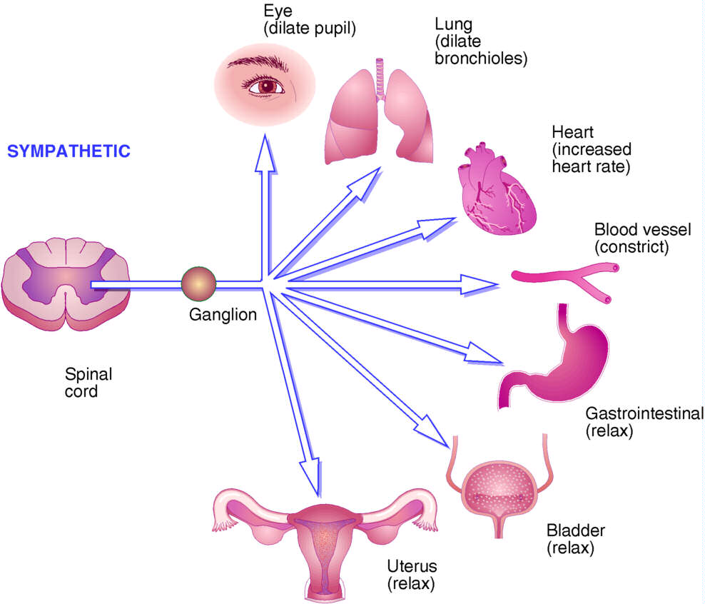
Sympathetic responses

Slide 19
1-Sympathetic cholinergic innervations is seen in-
  Apocrine sweat glands
  Eccrine sweat glands
  Iris
  Pancreas

Slide 20
2-Preganglionic sympathetic fibres are--
Small & Myelinated
Small & Nonmyelinated
Large & Myelinated
Large & Unmyelinated

Slide 21
3-Preganglionic sympathetic fibers innervating the heart are arises from--
C1-C6
T1-L2
T12-L5
T1-T5

Slide 22
4-Precapillary to post capillary resistance ratio is about--
4:1
1:2
2:1
1:4

Slide 23
5-Sympathetic Fibres to the heart are-
Endocardial
Epicardial
Serotonergic
Glycinergic

Slide 24
Applied Physiology
Horner's syndrome
Sympathomimetic drugs
Sympatholytic drugs
Parasympathomimetic drugs
Parasympatholytics drugs
Ganglion blocker

Slide 25


