Slide 1
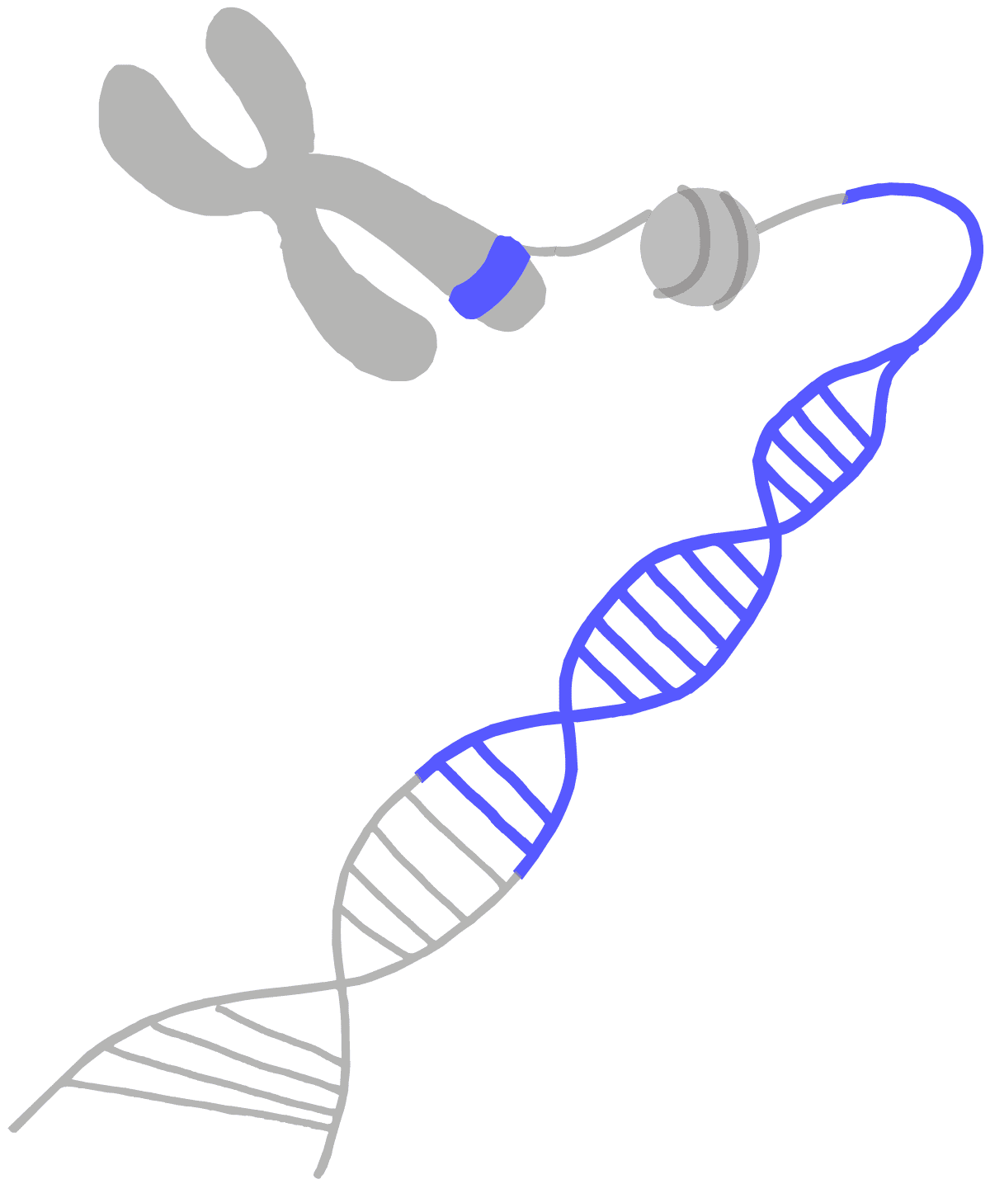
ALTERED GENE FUNCTION
III Pharm D Pharmacology II
Mr.Syamjith P
Associate Professor
Department of Pharmacology
DAMCOP

Slide 2
MUTATION
In biology, a mutation is an alteration in the nucleotide sequence of the genome of an organism, virus, or extra-chromosomal DNA.
Mutations result from errors during DNA replication, mitosis, and meiosis or other types of damage to DNA, which then may undergo error-prone repair or cause an error during other forms of repair or else may cause an error during replication (translation).
Mutations may also result from insertion or deletion of segments of DNA due to mobile genetic elements.

Slide 4
Gene Mutation
Point Mutation
Silent Mutation
Missense Mutation
Nonsense Mutation
Frame Shift Mutation
Insertion
Deletion
Base Substitution Mutation
Transition Mutation
Transversion Mutation

Slide 5
SUBSTITUTION
A substitution is a mutation that exchanges one base for another (i.e., a change in a single "chemical letter" such as switching an A to a G)
change a codon to one that encodes a different amino acid and cause a small change in the protein produced.
For example, sickle cell anemia is caused by a substitution in the beta-hemoglobin gene, which alters a single amino acid in the protein produced.
Change a codon to one that encodes the same amino acid and causes no change in the protein produced. These are called silent mutations.
change an amino-acid-coding codon to a single "stop" codon and cause an incomplete protein. This can have serious effects since the incomplete protein probably won't function.

Slide 6
SUBSTITUTION

Slide 7
POINT MUTATION
Also known as base pair substitution
Change a single nucleotide base pair
Types:-
Silent Mutation
Missense Mutation
Non sense Mutation

Slide 8
Silent Mutation
(Synonymous Mutation)
Silence mutations are a type of point mutation resulting in a codon that codes for the same or a different amino acid, without any functional change in the protein product.
Example: Silent mutations do not cause any disease because they don't alter the the organism itself.

Slide 11
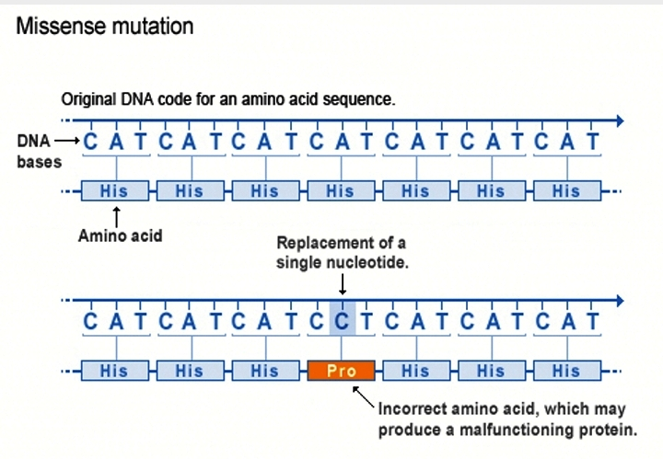

Slide 12
Frameshift mutation:
This type of mutation occurs when the addition or loss of DNA bases changes a gene’s reading frame.
A reading frame consists of groups of 3 bases that each code for one amino acid.
A frame shift mutation shifts the grouping of these bases and changes the code for amino acids.
The resulting protein is usually non-functional.
Insertions, deletions, and duplications can all be frame shift mutations.

Slide 14
Insertion or Deletion:
Insertions are mutations in which extra base pairs are inserted into a new place in the DNA.
An insertion changes the number of DNA bases in a gene by adding a piece of DNA.
A deletion removes a piece of DNA. Insertions or deletions may be small (one or a few base pairs within a gene) or large (an entire gene, several genes, or a large section of a chromosome).
In any of these cases, the protein made by the gene may not function properly.
Deletions are mutations in which a section of DNA is lost, or deleted.

Slide 15
INSERTION

Slide 16
DELETION

Slide 20
Duplication: A duplication consists of a piece of DNA that is abnormally copied one or more times. This type of mutation may alter the function of the resulting protein.

Slide 21
Deletion on a chromosome
In genetics, a deletion (also called gene deletion, deficiency, or deletion mutation) is a mutation (a genetic aberration) in which a part of a chromosome or a sequence of DNA is left out during DNA replication. Any number of nucleotides can be deleted, from a single base to an entire piece of chromosome. The smallest single base deletion mutations occur by a single base flipping in the template DNA, followed by template DNA strand slippage, within the DNA polymerase active site. Deletions can be caused by errors in chromosomal crossover during meiosis, which causes several serious genetic diseases.
Deletions that do not occur in multiples of three bases can cause a frameshift by changing the 3-nucleotide Protein reading frame of the genetic sequence. Deletions are representative of eukaryotic organisms, including humans and not in prokaryotic organisms, such as bacteria.

Slide 23
Types of deletion include the following
Terminal deletion – a deletion that occurs towards the end of a chromosome.
Intercalary deletion/interstitial addition – a deletion that occurs from the interior of a chromosome.
Micro-deletion – a relatively small amount of deletion (up to 5Mb that could include a dozen genes).
Micro-deletion is usually found in children with physical abnormalities. A large amount of deletion would result in immediate abortion (miscarriage).

Slide 24
CAUSES INCLUDE THE FOLLOWING:
Losses from translocation
Chromosomal crossovers within a chromosomal inversion
Unequal crossing over
Breaking without rejoining
For synapsis to occur between a chromosome with a large intercalary deficiency and a normal complete homolog, the unpaired region of the normal homolog must loop out of the linear structure into a deletion or compensation loop.

Slide 25
Effects
Small deletions are less likely to be fatal; large deletions are usually fatal.
Some medium-sized deletions lead to recognizable human disorders, e.g. Williams syndrome.
In contrast, a deletion that is evenly divisible by three is called an in-frame deletion.
Deletions -muscular dystrophy, cystic fibrosis, common genetic cause of infant death.

Slide 26
Gene amplification / Gene duplication /chromosomal duplication
Gene amplification refers to an increase in the number of copies of the same gene rather than to an increase in its rate of transcription.
It results from gene duplication that has been repeated many times over, producing from 100 to 1000 copies of the gene.

Slide 27
Is a major mechanism through which new genetic material is generated during molecular evolution.
It can be defined as any duplication of a region of DNA that contains a gene.
Gene duplications can arise as products of several types of errors in DNA replication and repair machinery as well as through fortuitous capture by selfish genetic elements.
Common sources of gene duplications include ectopic recombination, retrotransposition event, aneuploidy, polyploidy, and replication slippage.

Slide 29
Loss of heterozygosity (LOH) refers to a specific type of genetic mutation during which there is a loss of one normal copy of a gene or a group of genes. In some cases, loss of heterozygosity can contribute to the development of cancer.
In LOH, a gene or a whole group of neighbouring genes are lost and no longer present inside the affected cell. This could happen when that part of the DNA is accidentally deleted, perhaps when the cell is undergoing normal division and replication. The gene might be completely gone, or part of it might have been moved to another location on the DNA.

Slide 30
Loss of Heterozygosity (LOH)
Genetic mutation during which there is a loss of one normal copy of a gene or a group of genes.
loss of heterozygosity can contribute to the development of cancer.
In LOH, a gene or a whole group of neighbouring genes are lost and no longer present inside the affected cell.

Slide 31
Loss of Heterozygosity (LOH)
This could happen when that part of the DNA is accidentally deleted, perhaps when the cell is undergoing normal division and replication.
The gene might be completely gone, or part of it might have been moved to another location on the DNA.

Slide 32
Loss of Heterozygosity (LOH)
In either case, the protein encoded by the gene cannot be correctly made.
Instead of having two different versions of the same gene present (heterozygosity), one copy of the gene is now gone.﻿
This could happen when that part of the DNA is accidentally deleted, perhaps when the cell is undergoing normal division and replication

Slide 34
Translocation
Unusual rearrangement of chromosomes.
It is detected on cytogenetics or a karyotype of affected cells.
Type of chromosomal abnormality in which a chromosome breaks and a portion of it reattaches to a different chromosome.

Slide 35
TransloTranslocation cation
Genetic alterations in DNA can lead to cancer when it is present in
proto-oncogenes, tumor suppressor genes, DNA repair genes etc.
Chromosomal translocations in certain cases can result either in the fusion of genes or in bringing genes close to enhancer or promoter elements, hence leading to their altered expression.

Slide 37
Trinucleotide repeat disorders
They are a set of genetic disorders caused by trinucleotide repeat expansion, a kind of mutation in which repeats of three nucleotides (trinucleotide repeats) increase in copy numbers until they cross a threshold above which they become unstable.
Depending on where it is located, the unstable trinucleotide repeat may cause defects in a protein encoded by a gene, change the regulation of gene expression, produce a toxic RNA, or lead to chromosome instability.
In general, the larger the expansion the faster the onset of disease, and the more severe the disease becomes.

